Slide 1
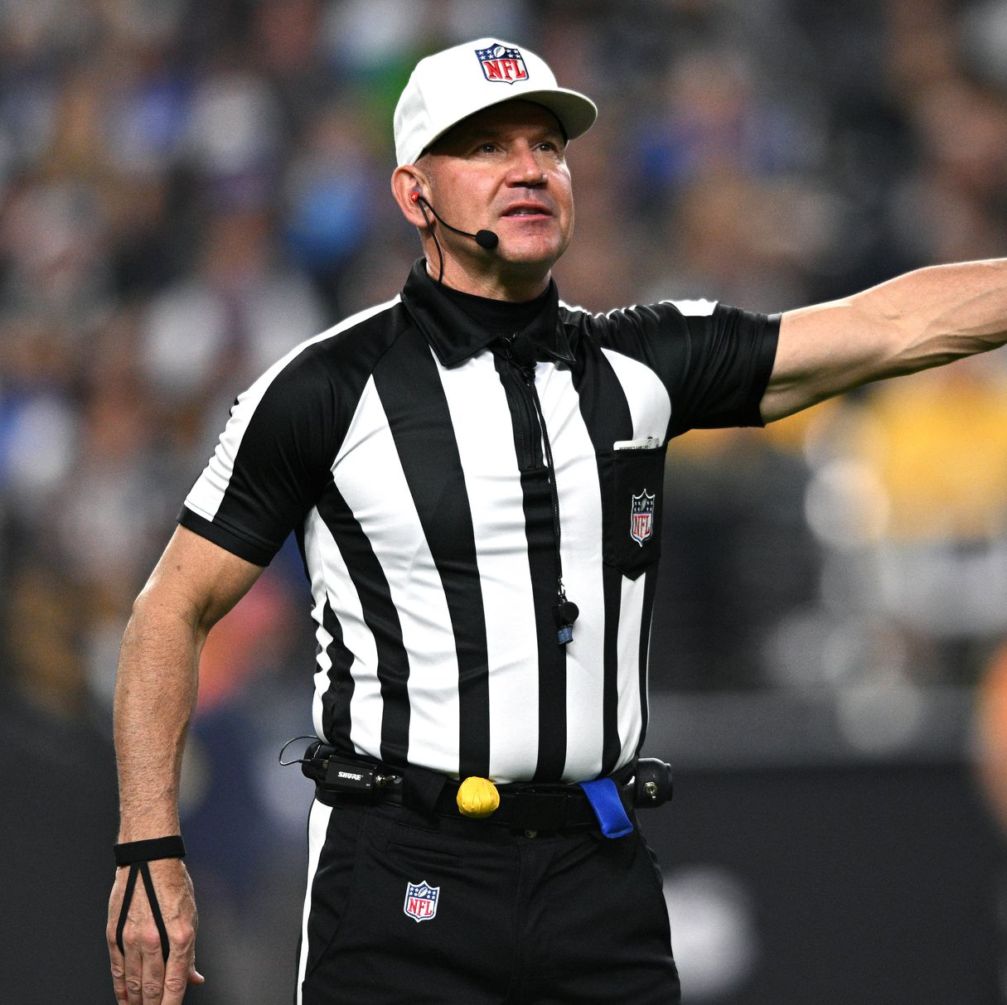
REFEREE
Leadership
“To Give Anything Less Than Your Best Is To Sacrifice the Gift”
Steve Prefontaine.

Slide 2
LEADERSHIP: THE ROLE OF THE CREW CHIEF
Definition of Leadership
Leadership is the ability of an individual or group to influence and guide others toward achieving common goals. It involves a combination of mindsets and behaviors that align people in a collective direction.
Key Aspects of Leadership
Influence: Leadership is fundamentally about social influence, where a leader inspires and motivates others.
Accountability: A leader takes responsibility for their actions and the outcomes of their decisions.
Vision: Effective leaders create a clear vision and direction for their teams or organizations.
Support and Development: Good leadership includes supporting team members and fostering their growth.
Leadership Styles
Different styles of leadership can be identified, including:
Transactional Leadership: Focuses on exchanges between leaders and followers, where rewards are given for meeting specific goals.
Transformational Leadership: Encourages leaders to inspire and motivate followers to exceed their own self-interests for the good of the group.
Laissez-Faire Leadership: Grants autonomy to team members, allowing them to make decisions and set their own goals.

Slide 3
Manage
The Pressure
Can the crew accept the challenge to focus every down for 175 plays?
Be GREAT Dead Ball Officials
Each official has a job, including during time outs. There is no appropriate time to relax. Remain Locked In!
Meet the moment: win each down, win each announcement.

Slide 4
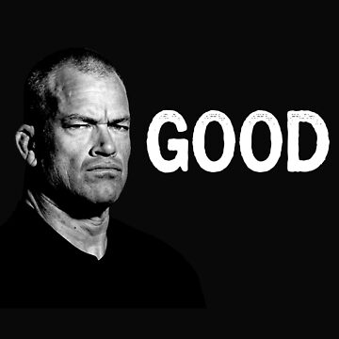
You Are A Problem Solver

Slide 5
It All Begins With Crew Preparation
Crew Organization: The crew wants to be lead so lead!
Set the vision, tone, expectation and standard of performance.
Pregame: “The lack of preparation shows the crew you really don’t care.”
Meet the moment.

Slide 6
Crew Mechanics
Focus on the basics:
Visual mechanics
Athletic movement: Posture
Be in the right position to rule on the action of the play
Strong mechanics will keep a crew out of trouble
Control the tempo, administration
Communicate, Communicate, Communicate; crews within the crews: eg; processing IDP, ING, DPI
Establish a consistent foul threshold: MAKE IT HUGE!
Own Penalty enforcement:
Optics: how does it play?
FOUL REPORTING: solve the riddle (open up the O2Os)
Be a high functioning crew: accuracy X speed = crew efficiency - get the focus off of the crew as quickly as possible.
We don’t sacrifice speed for accuracy. Slow is smooth and smooth is fast. There’s a lot of forgiveness from coaches when the optics and credibility of a crew is high.
Time Critical Situations: Under 2:00 Minutes 2Q/4Q
Time critical mechanics: Controlling Whistle – Winds Situations

Slide 7
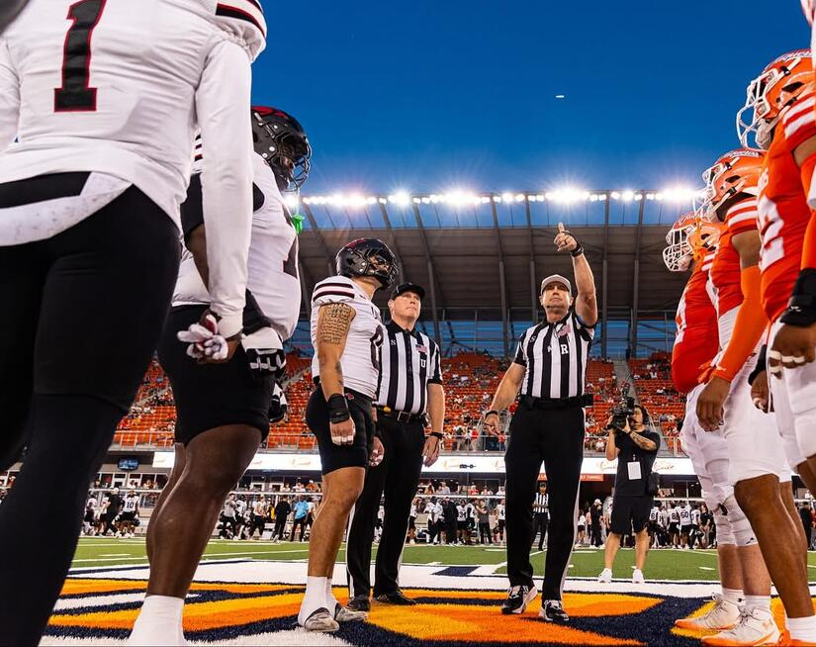
The Coin Toss: sets the tone. Optics of how things are going to be tonight.

Slide 8
Referee Announcements https://youtu.be/Fo88LaJIt5E
Rehearse, Rehearse, Rehearse and Rehearse some more.
Win each announcement
Penalty Enforcement:
  Foul Reporting Format:
  Solve the Riddle
    https://www.youtube.com/watch?v=Fo88LaJIt5E&pp=ygUdd2UnZXIgZGVhbGluZyB3aXRoIGEgbG90IHNoaXQ%3D

Slide 9
REFEREE POSITIONING: Free Kicks
Up the chute
  Align with the position of the kicking tee and ball
  Behind the deepest receiver
  Visual progressions, look through the receiver up the field “up the chute”
  Be able to see a potential valid or invalid fair catch signal
  Between the #’s to the hash
  Settle and work your progressions, move with purpose and establish presence near the pile and get involved with the DB action as needed. Let your crew work their ball mechanics.
  -Ball Position after a TB. R’s, are you asking this in pregame w/HCs?

Slide 10

REFEREE POSTIONING: Plays from scrimmage
Effective Presnap Routine
Setting the Tackle Box: one to two positions wider than the RT
Visual progressions: what is your I.R.S.?
ING: ball position: do you keep ball position?
  Let the QB and or passer cross your bow
  If he does, you know he’s out of the TB
  Pass plays: QB or passer rolls out to your left side

Slide 15
Congratulations and Good Luck!
Quality Leadership and Represent S.D.C.F.O.A.

