Slide 1

CIF Registration 2026-27
**Make sure to watch in Slideshow mode to be able to click the links that are embedded. **

Slide 2
Officials

Slide 3
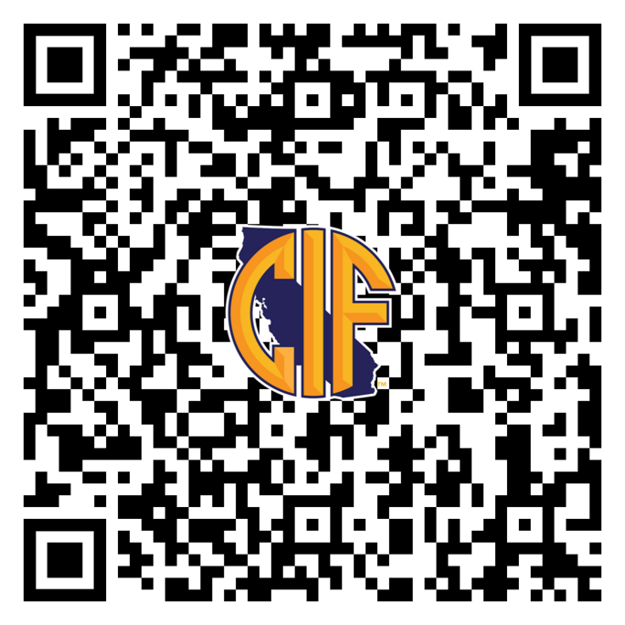
Registration
•New to Arbiter and Registration click HERE to register or visit the CIF Central Hub then click on the Registration Tab
•You can also scan the QR code to the right
Currently in CIF State Group (111820):
•Sign into arbiter.io using your Arbiter account.
•Go to the Eligibility tab
•Click on the Registration tab
•You will see the 2026-27 CIF Officials Registration option click on “Register”

Slide 4
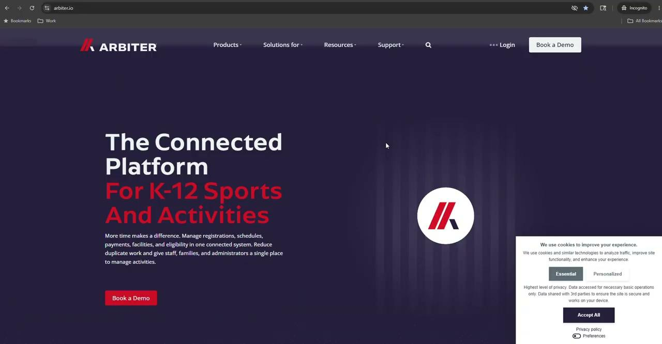
Registration
Registration walk-thru and Eligibility Requirements

Slide 5
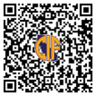
QA
•Where do I go to Register? https://app.arbitersports.com/registration/official/register/5749?org=9529&role=3
•Why do I need to Register? CIF is requiring all officials to be compliant with state rules
•Am I required to have a background check done? Yes
•If my associations have their own registration do I still need to do the CIF one? Yes
•If my association has their own test do I need to do both tests? No
•Where do I go to take the test? You can go to your Eligibility Page > Eligibility > click the 2026-27 CIF Registration Eligibility > then click on the blue link that says “Take Test”. You can also find the tests on the CIF Central Hub
•How do I access the rules books? Instructions on how to receive/access the rules books will be sent by NFHS once you register
•Do I have insurance when I register? Yes, you will be provided insurance by the NFHS. Insurance information can be found HERE
•Contact Information:
•success@arbitersports.com
•1-800-311-4060
•Help Articles
•How do I become a member of the CIF? To register click this link: https://app.arbitersports.com/registration/official/register/5749?org=9529&role=3
•You can also scan this QR code:
•Do I need to renew my membership every year? Yes, each year you will need to register for that current season
•What are the yearly requirements of membership? Registration, background check, testing A and B in most sports
•What is ArbiterPay? Schools and Assignors can pay you via ArbiterPay. The account is free to sign up for. You can do this via registration or clicking HERE for more information.

Slide 6
Assigners

Slide 7
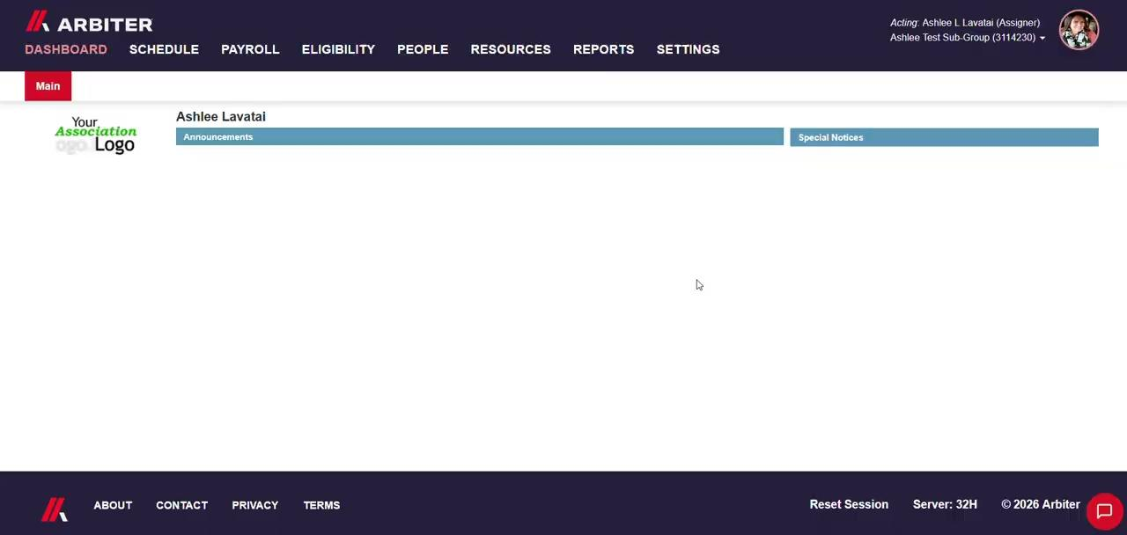
Adding Officials
•Use this if officials didn’t pick your assigning group originally during registration:
•Click on the People Tab
•Click on the Officials Tab
•Click on the green + sign
•On the next screen click on the dropdown where is says “All Eligibility Periods”
•Pick your Sport and Year
•Or search officials last name in the upper right hand corner
•Check box next to their name
•Click on “Add Official”

Slide 8
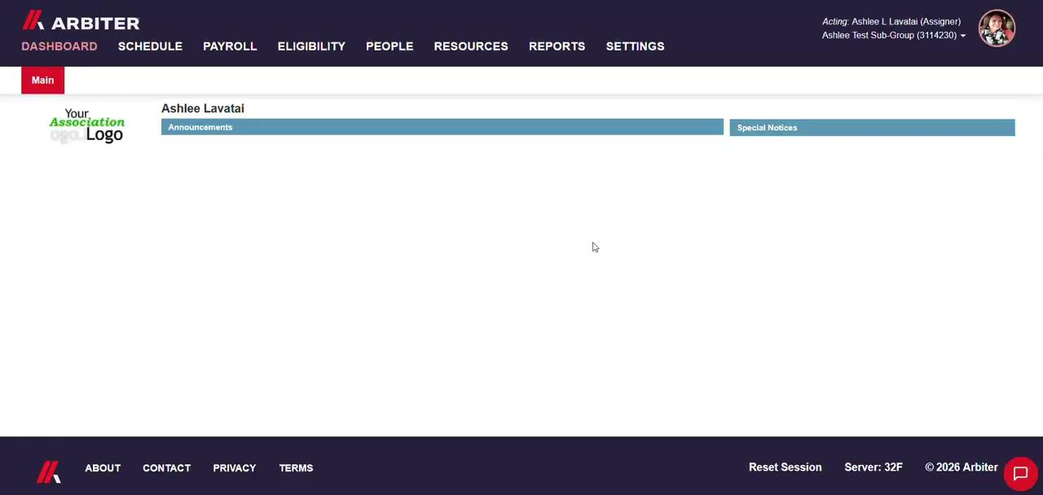
Creating Filters
•Go to the People Tab
•Click on the Officials Tab
•Click on Create Filter
•Name your Filter 2026-27 Eligible Registrations – something like that
•Scroll down to the “Eligibility Period”
•Click on the dropdown to “Eligible”
•Pick your Sport 2026-27 CIF Registration – Baseball
•Click on Save

Slide 9

Monitor Eligibility
•Click on the Eligibility Tab
•Click on Monitor Eligibility
•Type: “Officials”
•Date Registered: Any range
•Sport/Activity if you would like
•Shows Badge under Current Eligibility column if completed all requirements
•Can click into the official by clicking on their name to see individually what they need to complete

Slide 10
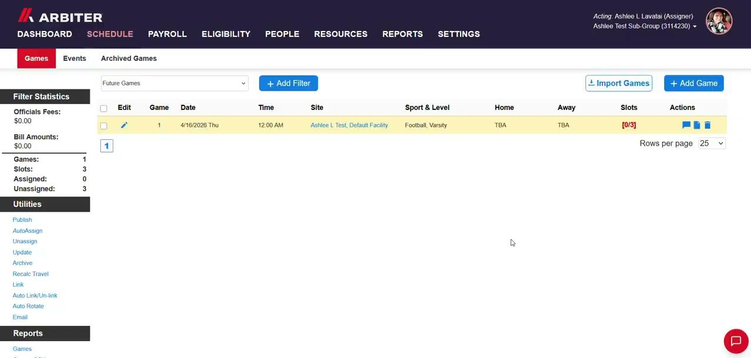
Assigning
•Click on the Schedule Tab
•Find the game that you are needing to assign
•Click on the numbers in the slots column
•Click on Assign next to the position you want to assign for
•On this next screen you will see available officials who are eligible by looking in the eligibility column to see the badges (the system won’t allow you to assign unless they are registered and completed all the requirements)

Slide 11

QA
•How do I know if an official picks me as their assigner group? You will receive an email notification when an official picks you as their association, only if they are not currently in your group.
•Where do officials find registration? https://app.arbitersports.com/registration/official/register/5749?org=9529&role=3
•They can also find registration via the QR code:
•Can I still do my membership dues if I have been? Yes, you can continue to do your membership dues as normal. Keep in mind the state is doing background checks so you can remove that from your membership eligibility.
•Contact Information:
•Assigners@arbitersports.com
•1-800-311-4060
•Help Articles
•Where do I go to look at officials eligibility? Eligibility Tab > Monitor Eligibility
•Can I use my own test? If your association has a test then yes you can use your own. We are working with CIF to see how to allow this to show from the state level. You can send to the state and we will get it added. (excel files work best)
•Do I need to run background checks anymore? The state will be running them so you don’t need to run them. The officials eligibility will be passed down via their unique identifier (email).
•How do I know if an official is eligible? They will show an eligibility badge
•Are they required to register in order for me to assign them to games? Yes, CIF is requiring all officials to be registered for High School contests

