Slide 1
Flag Football Basics
2026 Review
Katie Ott

Slide 2
Mechanics changes
Field Judge is now the Line Judge
  Initial position is on the LOS
  In certain situations the Referee may instruct the LJ to move to the line to gain or the goal line
Scrimmage kick
  Both HL and LJ initial position is with the deep receiver
  R has responsibility for the LOS (snap, kick crossing the line)

Slide 3
New & Updated Rules
1-1-3: All teams must begin with 7 players
2-18: Provides the definition of hurdling (already a foul)
3-4-4e: Two minute warning is not a timeout
3-5-1: Increases team timeouts per half to 3
9-7-4: Ball in player possession shall not be batted, stripped, or attempted to be stripped (Illegal batting - 10yd penalty)

Slide 4
New & Updated Rules
2-36-10, 3-4-3-l, 4-1-1, 8-3-9 exception, 8-4-3 exception:
  The scoring team may (if trailing in score) elect to keep possession of the ball. The scoring team would take possession, fourth down, on their own 20-yard line. All rules, including timing, for a scrimmage down apply.
4-1-1 & 8-5-5:
  The team whose goal line was not involved shall put the ball in play by a scrimmage kick from its own 20-yard line after a safety.

Slide 5
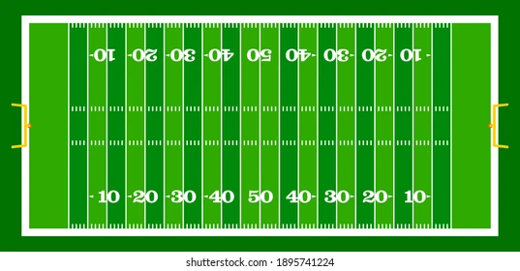
The Field
40 yards wide x 80 yards long
2, 10 yard end zones
4 different possible configurations - most schools will use the lacrosse lines
Emphasis for this year - team box

Slide 6
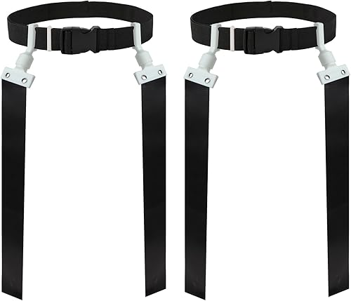
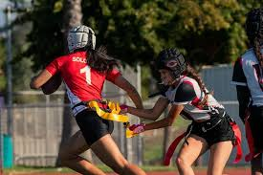
The Equipment
Ball
  Tan color
  Youth size
Mouth Piece
  Mandatory
Flags
  Pop style or Velcro
  Single solid color
  One belt
Soft helmets
  Legal if worn correctly
Adornments
  Sunglasses
    LEGAL unless prohibited by NFHS
  Jewelry
    Illegal *Silicone plugs are OK and should be suggested for jewelry that cannot be removed
    Religious and medical medals not considered jewelry but must be taped down
  Face Paint
    Only a single swipe under the eye is legal

Slide 7

The Uniform
Jersey
  MUST be tucked in
Bottoms
  No pockets
  No zippers
  No belt loops
  No stripes
Flags
  One flag on each side, check before each snap
  Elbows out
  Worn around the waist not the hips
  Contrasting color from shorts
  Potential flag guarding penalty if flags shift after possession causing material impact on defender’s ability to pull the flag

Slide 8
Pre-Game
Conference with the coaches
  Accompany the R to talk to the coaches
  R will use this as a time to talk to coaches about unusual plays, jewelry, jerseys, flags
  Confirm that all players are legally equipped by rule
  Discuss team box restrictions
Equipment checks
  No formal lineups
  Observe teams/players during warm-ups
  Talk to coaches if you see anything
Pre-game responsibilities
  Head Line Judge – instruct the down box
  Line Judge – instruct the clock

Slide 9
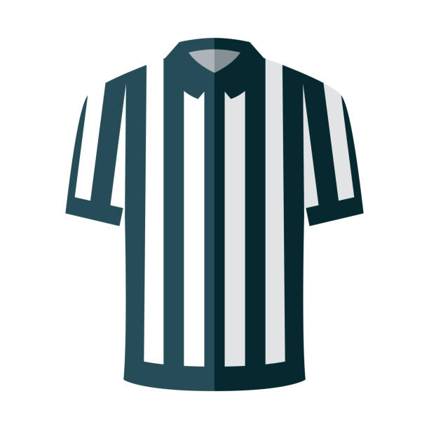

Mechanics
Head Line Judge
  Initial position is on the LOS
  Make sure the down box is in the correct spot and displays the correct down
  Mark the LOS for the defense (1 yard off the ball)
  Responsible for sideline, endline to endline
Line Judge
  Initial position is on the LOS, on sideline opposite of HL
    In certain situations the Referee may instruct the LJ’s original position at line to gain or goal line
  Count the defense
  Mark the LOS for the defense (1 yard off the ball)
  Responsible for sideline, endline to endline
Referee
  Initial position 12-15 yards back from the LOS
  Count the offense
  Responsible for play clock
  Rule on fouls on the QB
  Spots the ball

Slide 10
The Game
Each game consists of 4, 12 minute quarters
Each half, and each new series following a TD starts from the offense’s 14 yard line (A-14)
4 downs to reach the next zone to gain
If a foul takes a team backwards into a different zone, they still have to reach the original zone to gain in order to get a first down

Slide 11
The Game - Timing
Each team has 3 timeouts per half, they do not carry over
Clock will stop for:
  Down ends where there is a penalty
  Team or Official’s time out
  A score
  A touchback
  Inadvertent whistle
  2 minute timeout
  New series for B
  Incomplete pass (final 2 minutes of each half)
  Ball runner goes out of bounds (final 2 minutes of each half)
  Offense is awarded a 1st down, clock will start on the ready for play (final 2 minutes of each half)
Mercy rule:
  When the point margin exceeds 27 points in the 4th quarter, the clock will run continuously for the remainder of the game. The game clock will only stop for team timeouts and officials’ timeouts.

Slide 12
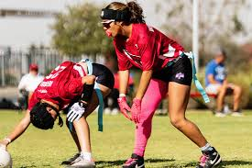
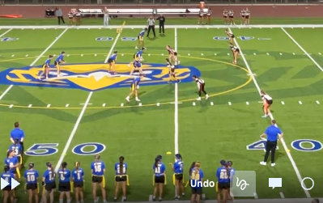
The Game – Scrimmage Plays
Offense
Only the Snapper must be on the line of scrimmage
Side snap or between the legs are both legal
Hand to hand snap is ILLEGAL
All players must be in different numbers
QB must be two yards back from the LOS to receive the snap
Only one forward pass, unlimited backward passes
Defense
Defensive scrimmage line is 1 yard off the ball
Lining up ANYWHERE within that 1 yard is Encroachment

Slide 13
The Game – Fumbles, Muff, Backwards Pass
Fumble, Muff, & Backwards Passes
  Dead ball once grounded
  Live ball if recovered before being grounded
Spot following a forward fumble
  Returned to the spot of the fumble / end of the run
The ball belongs to the passing or fumbling team unless lost after fourth down

Slide 14
The Game - Blocking
Blocking
  Blocking is illegal
  Legal Screen blocking is allowed anywhere on the field
    No extended arms, use of hands, arms, elbows, or legs
  Judgement
    Right of Place = Defender has established position in front of blocker or runner
    Right of Way = Blocker or runner who is moving may not be contacted by a defender in motion
    Right of Place supersedes Right of Way
    Once the defender has established a right of way, the blocker must avoid contact

Slide 15
The Game - Blocking
Officials must watch the initial positioning of the screener, not just the contact
A screener may NOT:
  Step too close behind a stationary opponent
    Guidance is 1-2 steps based on speed of defender
  Initiate contact when taking position in front or to the side
    Defender allowed to stop or change direction
  Establish a position too close to a moving opponent
    Defender must have opportunity to avoid contact
Screener can only move
  In the same direction of the defender
  Along the same path of the defender
Movement to maintain a position, with contact is an illegal block

Slide 16
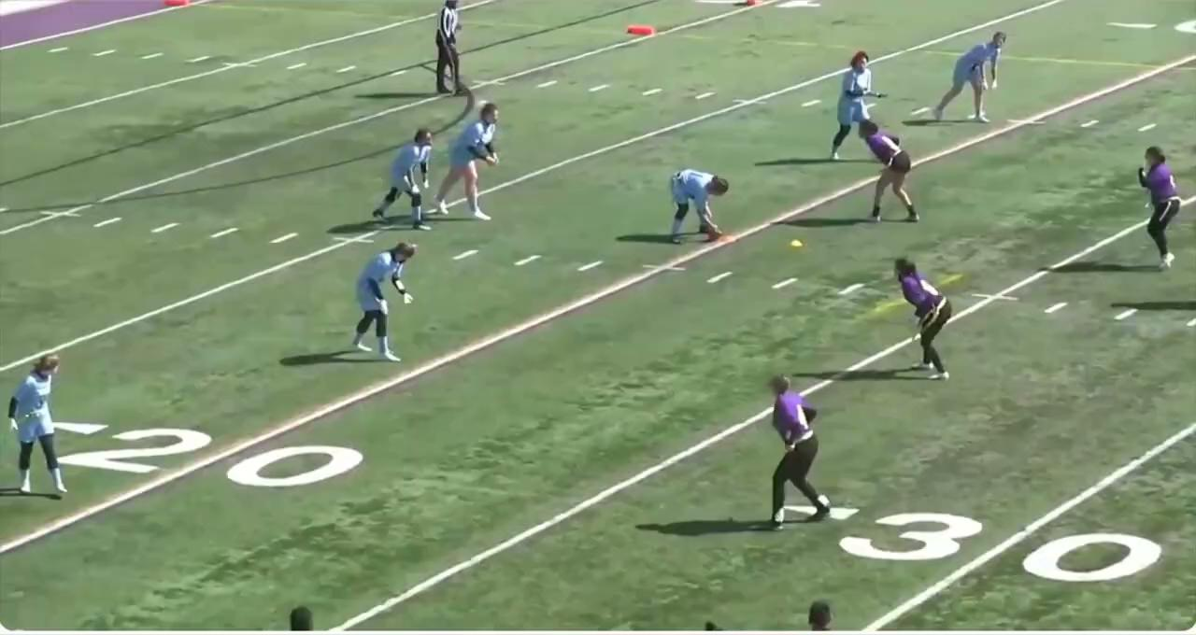

Slide 17
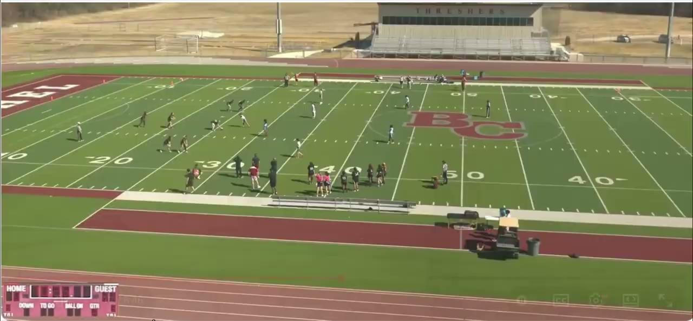

Slide 18
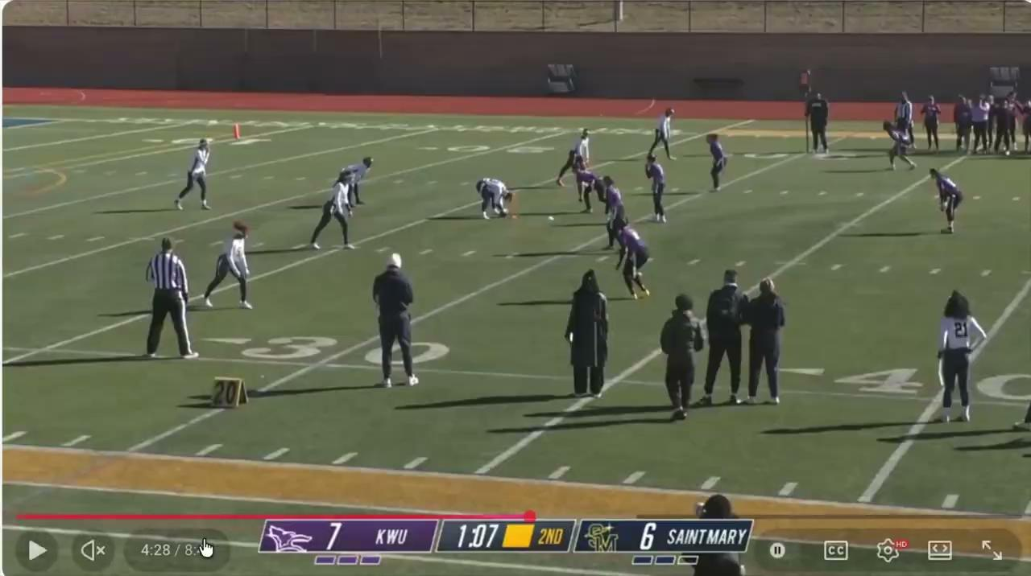

Slide 19
The Game - Kicking
Kicking
  No kickoffs – each new drives at the 14 yard line
    Exceptions: After a safety, the ball will be put in play by a scrimmage kick from the 20 yard line
  Scrimmage kicks – only punts
    K must declare punt or play on 4th down; if they delay the R will mark the ball ready for play
    Timeout required to change declaration
    If punt is declared all players must be stationary until the ball is kicked
    If punt is declared, R will hold the snap while defense subs (up to 20s on play clock)
  R can catch or recover a kick and advance
  If R muffs or fumbles the kick and it hits the ground the ball is dead
  If R muffs the kick and K recovers the ball while it is still in the air, the ball is dead and it is K’s ball
  Touchbacks – once the kick breaks the plane of the goal line, the ball is dead and it is a touchback
  Kick Catching interference – same as in tackle

