Slide 1
Flag Football Basics
2025 Review
Katie Ott

Slide 2
The Field
40 yards wide x 80 yards long
2, 10 yard end zones
4 different possible configurations

Slide 3
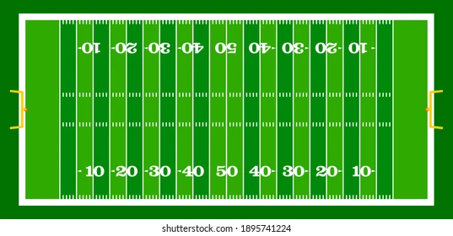
The Field
10 yard line to 10 yard line, centered on the field (CIF standard)

Slide 4
The Field
10 yard line to 10 yard line, using the sideline

Slide 5
The Field
Use of one end zone, centered on the field

Slide 6
The Field
Using one end zone, using the sideline

Slide 7
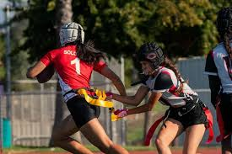
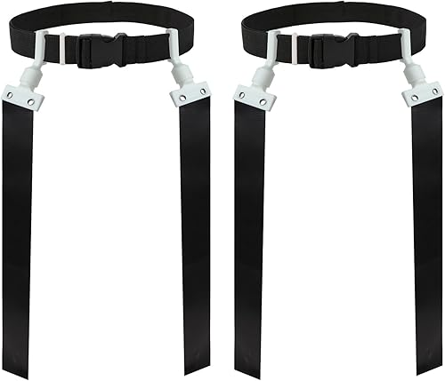
The Equipment
Ball
  Tan color
  Smaller size
Mouth Piece
  Mandatory
Flags
  Pop style or Velcro
  Single solid color
  One belt
Soft helmets
  Legal if worn correctly
Adornments
  Sunglasses
    Illegal unless prescription
  Jewelry
    Illegal
    Religious and medical medals not considered jewelry
  Face Paint
    Only a single swipe under the eye is legal

Slide 8
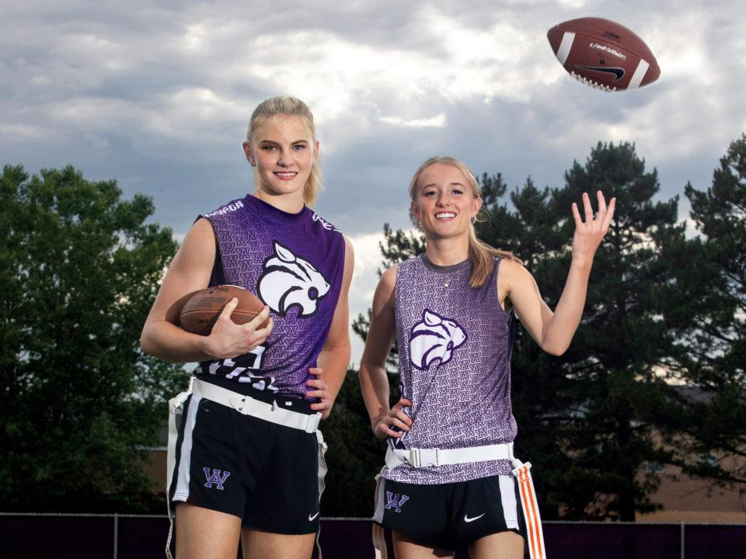
The Uniform
Jersey
  MUST be tucked in
Bottoms
  No pockets
  No zippers
  No belt loops
Flags
  On the hips
  Flared out

Slide 9
Pre-Game
Conference with the coaches
  Accompany the R to talk to the coaches
  R will use this as a time to talk to them about unusual plays, jewelry, jerseys, flags
Equipment checks
  No formal lineups
  Observe teams/players during warm-ups
  Talk to coaches if you see anything
Pre-game responsibilities
  Head Line Judge – instruct the down box
  Field Judge – instruct the clock

Slide 10
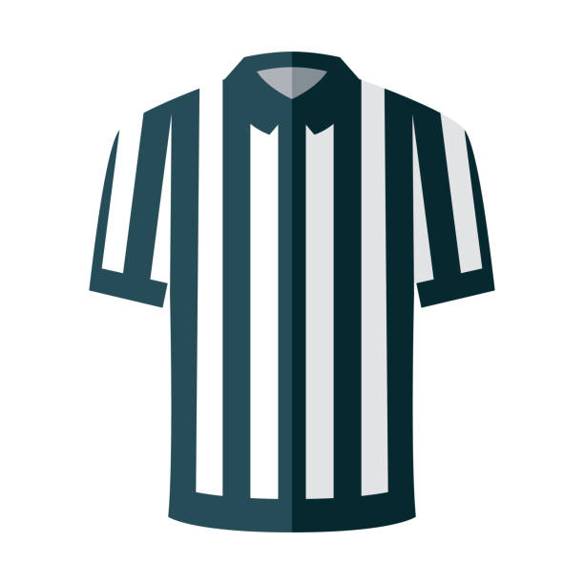

Mechanics
Head Line Judge
  Initial position is on the LOS
  Make sure the down box is in the correct spot and displays the correct down
  Mark the LOS for the defense (1 yard off the ball)
  Responsible for sideline, endline to endline
Field Judge
  Initial position is 15-20 yards downfield, on sideline opposite of HL
  Count the defense
  Responsible for sideline, endline to endline
  Responsible for the Goal line and End line
Referee
  Initial position 12-15 yards back from the LOS
  Count the offense
  Responsible for play clock
  Rule on fouls on the QB

Slide 11
The Game
Each game consists of 4, 12 minute quarters
Each half, and each new series following a TD starts from the offense’s 14 yard line (A-14)
4 downs to reach the next zone to gain
If a foul takes a team backwards into a different zone, they still have to reach the original zone to gain in order to get a first down

Slide 12
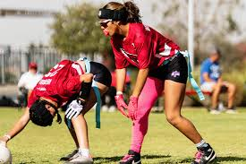
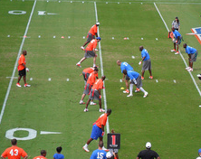
The Game – Line of Scrimmage
Offense
Only the Snapper must be on the line of scrimmage
Side snap or between the legs are both legal
All players must be in different numbers
Defense
Defensive scrimmage line is 1 yard off the ball

Slide 13
The Game - Timing
Each game consists of 4, 12-minute quarters
Each team has 2 timeouts per half, they do not carry over
Clock will stop for:
  Down ends where there is a penalty
  Official’s time out
  A score
  A touchback
  Inadvertent whistle
  2 minute timeout
  Incomplete pass (final 2 minutes of each half)
  Ball runner goes out of bounds (final 2 minutes of each half)
  Offense is awarded a 1st down, clock will start on the ready for play (final 2 minutes of each half)

Slide 14
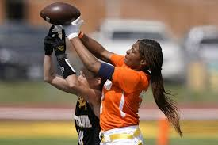
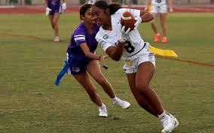
The Game – Scrimmage Plays
Passes
  One forward pass per down
  Unlimited backwards passes
Running plays
  Unlimited running plays
  Unlimited QB runs
  One forward handoff per down
  Unlimited backwards handoffs

Slide 15
The Game – Fumbles, Muff, Backwards Pass
Fumble, Muff, & Backwards Passes
  Dead ball once grounded
  Live ball if recovered before being grounded
Fumble forward out of bounds
  Returned to the spot of the fumble
The ball belongs to the passing or fumbling team unless lost after fourth down

Slide 16
The Game – Dead ball
The following cause the ball to become dead
  Flag is pulled
  Runner goes out of bounds
  When a player with only one flag is touched between the shoulder and knee
  Scrimmage kick crosses the Goal Line
  Grounded fumble, muff, or backwards pass

Slide 17
The Game - Blocking
Blocking
  Blocking is illegal
  Legal Screen blocking is allowed anywhere on the field
    No extended arms, use of hands, arms, elbows, or legs
  Judgement
    Right of Place = Defender has established position in front of blocker or runner
    Right of Way = Blocker or runner who is moving may not be contacted by a defender in motion
    Right of Place supersedes Right of Way

Slide 18
The Game - Kicking
Kicking
  No kickoffs – will start new drives at the 14 yard line
    Exceptions: Punts and Safety
  Scrimmage kicks – only punts
    K must declare punt or play on 4th down
    If punt is declared all players must be stationary until the ball is kicked
  R can catch or recover a kick and advance
  If R muffs or fumbles the kick and it hits the ground the ball is dead
  If R muffs the kick and K recovers the ball while it is still in the air, the ball is dead and it is K’s ball
  Touchbacks – once the kick breaks the plane of the goal line, the ball is dead and it is a touchback
  Kick Catching interference – same as in tackle

Slide 19
The Game - Scoring
Starting LOS
Scoring
  TD
    6 pt
  Try
    1 pt from the 3 yard line
    2 pt from the 10 yard line
    Drive following a try starts on the 14 yard line
  Safety
    2 pts
    Drive following a safety starts on the 30 yard line
LOS after safety
2 pt try
1 pt try

Slide 20
Common Offensive Fouls
False Start
Illegal Shift / Motion
Sideline interference, 3+
Helping the runner
Flag Guarding
Illegal Blocking
Pass Interference
Intentional Grounding (loss of down)
Illegal forward pass – watch for the double pass (loss of down)

Slide 21
Common Defensive Fouls
Encroachment
Pass Interference
Holding
Charging into the player (automatic first down)
Roughing the Passer (automatic first down)
Hurdling (automatic first down)
Tripping (automatic first down)
Illegal personal contact (automatic first down)
Unsportsmanlike conduct (automatic first down)
Sideline interference 3+ (automatic first down)

