Slide 1
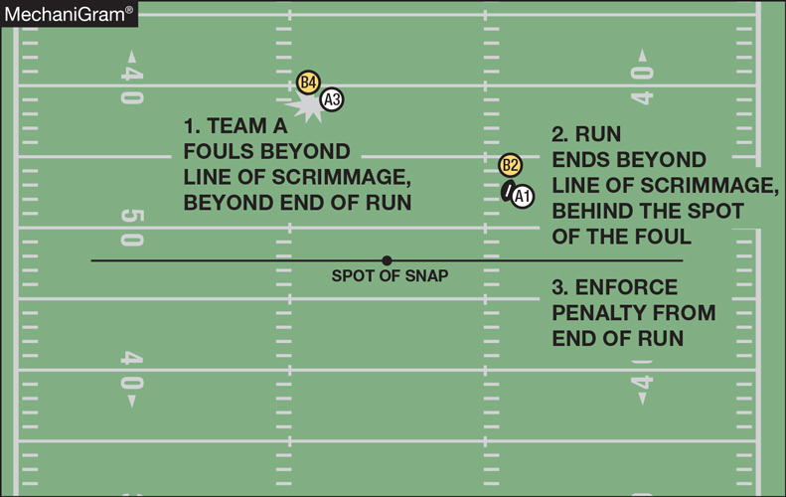
Rule 10-4-5e basic spot for running play penalty enforcement
The enforcement spot is the end of the run, or related run, for a foul by A that occurs beyond the line of scrimmage during a running play as defined in 10-3-2 when the run or related run ends beyond the line of scrimmage and the foul occurs in advance of the end of the run or related run.
Notes:
Comment on Slide:
See comments on slide.

