Slide 1
Flag Football Basics
2026 Review
Katie Ott

Slide 2
Mechanics changes
Field Judge is now the Line Judge
  Initial position is on the LOS
  In certain situations the Referee may instruct the LJ to move to the line to gain or the goal line
Scrimmage kick
  Both HL and LJ initial position is with the deep receiver
  R has responsibility for the LOS (snap, kick crossing the line)

Slide 3
New & Updated Rules
1-1-3: All teams must begin with 7 players
2-18: Provides the definition of hurdling (already a foul)
3-4-4e: Two minute warning is not a timeout
3-5-1: Increases team timeouts per half to 3
9-7-4: Ball in player possession shall not be batted, stripped, or attempted to be stripped (Illegal batting - 10yd penalty)

Slide 4
New & Updated Rules
2-36-10, 3-4-3-l, 4-1-1, 8-3-9 exception, 8-4-3 exception:
  The scoring team may (if trailing in score) elect to keep possession of the ball. The scoring team would take possession, fourth down, on their own 20-yard line. All rules, including timing, for a scrimmage down apply.
4-1-1 & 8-5-5:
  The team whose goal line was not involved shall put the ball in play by a scrimmage kick from its own 20-yard line after a safety.

Slide 5
The Field
40 yards wide x 80 yards long
2, 10 yard end zones
4 different possible configurations

Slide 6
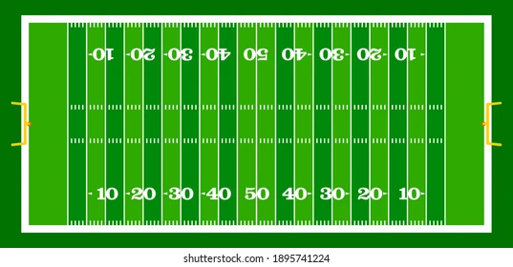
The Field
10 yard line to 10 yard line, centered on the field (CIF standard)
Use standard hash marks

Slide 7
The Field
10 yard line to 10 yard line, using the sideline
Use cones or pylons outside each end line 23’ apart from each other

Slide 8
The Field
Use of one end zone, centered on the field
Use standard hash marks

Slide 9
The Field
Using one end zone, using the sideline
Use cones or pylons outside each end line 23’ apart from each other

Slide 10
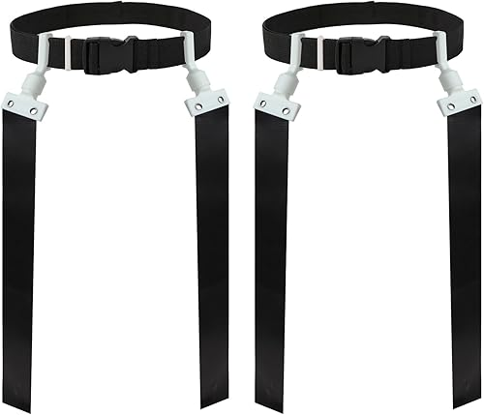
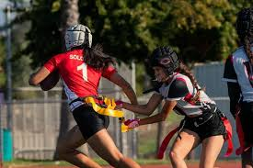
The Equipment
Ball
  Tan color
  Youth size
Mouth Piece
  Mandatory
Flags
  Pop style or Velcro
  Single solid color
  One belt
Soft helmets
  Legal if worn correctly
Adornments
  Sunglasses
    LEGAL unless prohibited by NFHS
  Jewelry
    Illegal *Silicone plugs are OK and should be suggested for jewelry that cannot be removed
    Religious and medical medals not considered jewelry
  Face Paint
    Only a single swipe under the eye is legal

Slide 11

The Uniform
Jersey
  MUST be tucked in
Bottoms
  No pockets
  No zippers
  No belt loops
Flags
  On the hips
  Elbows out
  Worn around the waist not the hips
  Contrasting color from shorts
  Potential flag guarding penalty if flags shift after possession causing material impact on defender’s ability to pull the flag

Slide 12
Pre-Game
Conference with the coaches
  Accompany the R to talk to the coaches
  R will use this as a time to talk to coaches about unusual plays, jewelry, jerseys, flags
  Confirm that all players are legally equipped by rule
  Discuss team box restrictions
Equipment checks
  No formal lineups
  Observe teams/players during warm-ups
  Talk to coaches if you see anything
Pre-game responsibilities
  Head Line Judge – instruct the down box
  Line Judge – instruct the clock

Slide 13
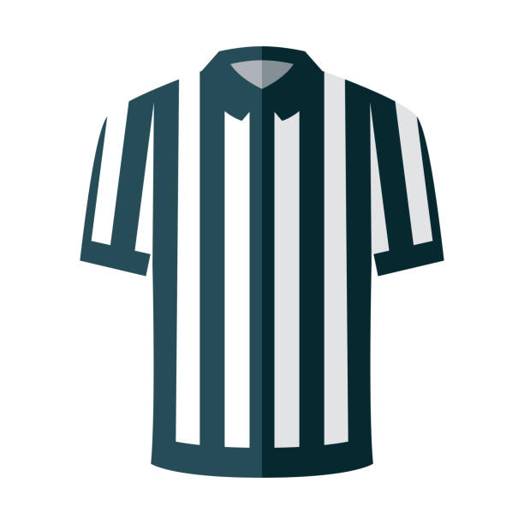

Mechanics
Head Line Judge
  Initial position is on the LOS
  Make sure the down box is in the correct spot and displays the correct down
  Mark the LOS for the defense (1 yard off the ball)
  Responsible for sideline, endline to endline
Line Judge
  Initial position is on the LOS, on sideline opposite of HL
    In certain situations the Referee may instruct the LJ’s original position at line to gain or goal line
  Count the defense
  Mark the LOS for the defense (1 yard off the ball)
  Responsible for sideline, endline to endline
Referee
  Initial position 12-15 yards back from the LOS
  Count the offense
  Responsible for play clock
  Rule on fouls on the QB
  Spots the ball

Slide 14
The Game
Each game consists of 4, 12 minute quarters
Each half, and each new series following a TD starts from the offense’s 14 yard line (A-14)
4 downs to reach the next zone to gain
If a foul takes a team backwards into a different zone, they still have to reach the original zone to gain in order to get a first down

Slide 15
The Game - Timing
Each team has 3 timeouts per half, they do not carry over
Clock will stop for:
  Down ends where there is a penalty
  Team or Official’s time out
  A score
  A touchback
  Inadvertent whistle
  2 minute timeout
  New series for B
  Incomplete pass (final 2 minutes of each half)
  Ball runner goes out of bounds (final 2 minutes of each half)
  Offense is awarded a 1st down, clock will start on the ready for play (final 2 minutes of each half)
Mercy rule:
  When the point margin exceeds 27 points in the 4th quarter, the clock will run continuously for the remainder of the game. The game clock will only stop for team timeouts and officials’ timeouts.

Slide 16
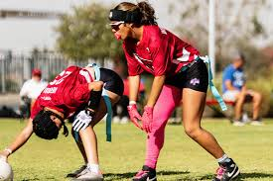
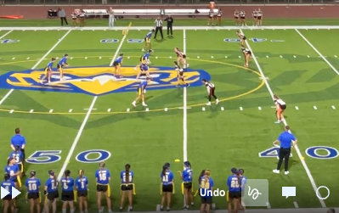
The Game – Line of Scrimmage
Offense
Only the Snapper must be on the line of scrimmage
Side snap or between the legs are both legal
All players must be in different numbers
QB must be two yards back from the LOS to receive the snap
Defense
Defensive scrimmage line is 1 yard off the ball
Lining up ANYWHERE within that 1 yard is Encroachment

Slide 17
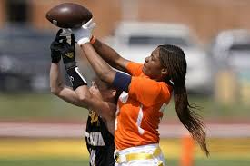
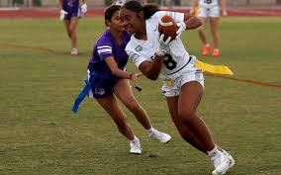
The Game – Scrimmage Plays
Passes
  One forward pass per down
  Unlimited backwards passes
Running plays
  Unlimited running plays
  Unlimited QB runs
  Forward handoff only behind the LOS
  Unlimited backwards handoffs

Slide 18
The Game – Fumbles, Muff, Backwards Pass
Fumble, Muff, & Backwards Passes
  Dead ball once grounded
  Live ball if recovered before being grounded
Spot following a fumble
  Returned to the spot of the fumble / end of the run
The ball belongs to the passing or fumbling team unless lost after fourth down

Slide 19
The Game – Dead ball
The following cause the ball to become dead
  Flag is pulled
  Runner goes out of bounds
  When a player with only one flag is touched between the shoulder and knee
  Scrimmage kick crosses the Goal Line
  Grounded fumble, muff, or backwards pass

Slide 20
The Game - Blocking
Blocking
  Blocking is illegal
  Legal Screen blocking is allowed anywhere on the field
    No extended arms, use of hands, arms, elbows, or legs
  Judgement
    Right of Place = Defender has established position in front of blocker or runner
    Right of Way = Blocker or runner who is moving may not be contacted by a defender in motion
    Right of Place supersedes Right of Way
    Once the defender has established a right of way, the blocker must avoid contact

Slide 21
The Game - Blocking
Officials must watch the initial positioning of the screener, not just the contact
A screener may NOT:
  Step too close behind a stationary opponent
    Guidance is 1-2 steps based on speed of defender
  Initiate contact when taking position in front or to the side
    Defender allowed to stop or change direction
  Establish a position too close to a moving opponent
    Defender must have opportunity to avoid contact

Slide 22
The Game - Blocking
Maintaining the block
  After establishing position (right of place) screener cannot move to maintain the block
  If they move, they give up right of place and the defender will have an established right of way
  Screener can only move
    In the same direction of the defender
    Along the same path of the defender
  Movement to maintain a position, with contact is an illegal block

Slide 23
The Game - Blocking
Using our judgement
Screen blocking must occur without initiating contact
Watch the setup - distance and movement
Defender must be able to stop, change direction, or avoid the screen
Hands, legs outside the frame of the body are good indicators of illegal blocking

Slide 24
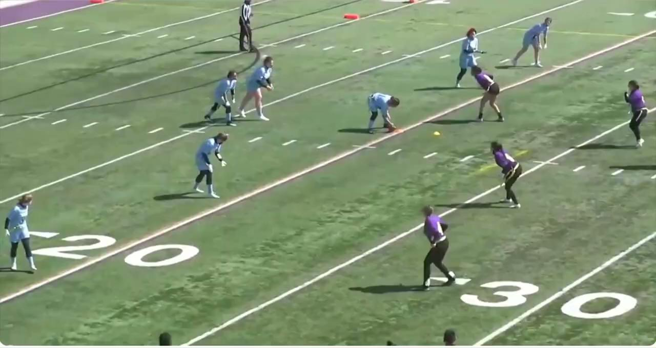

Slide 25
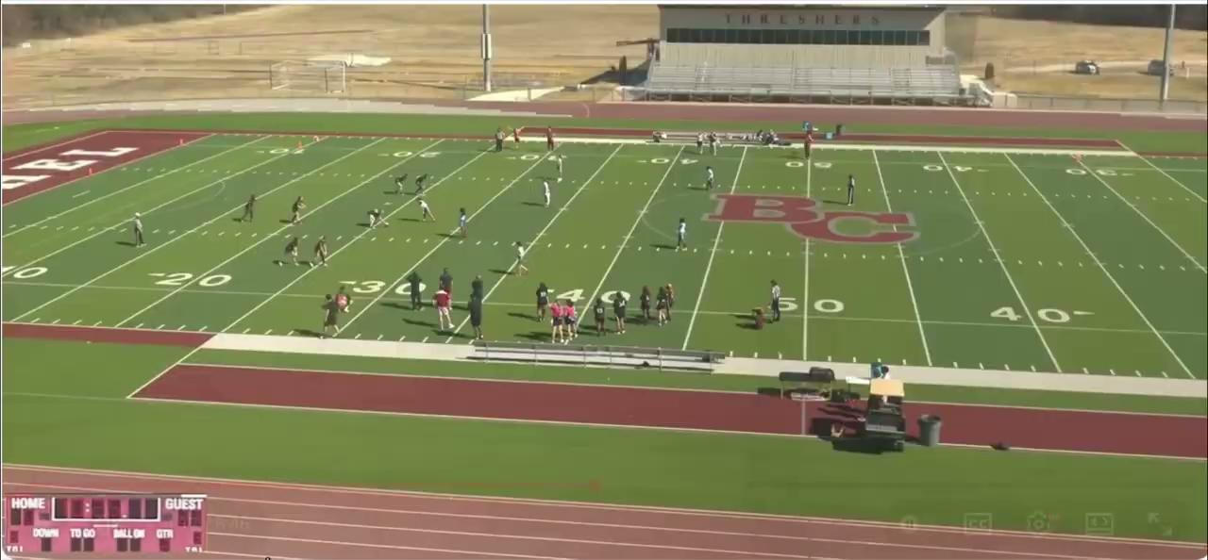

Slide 26
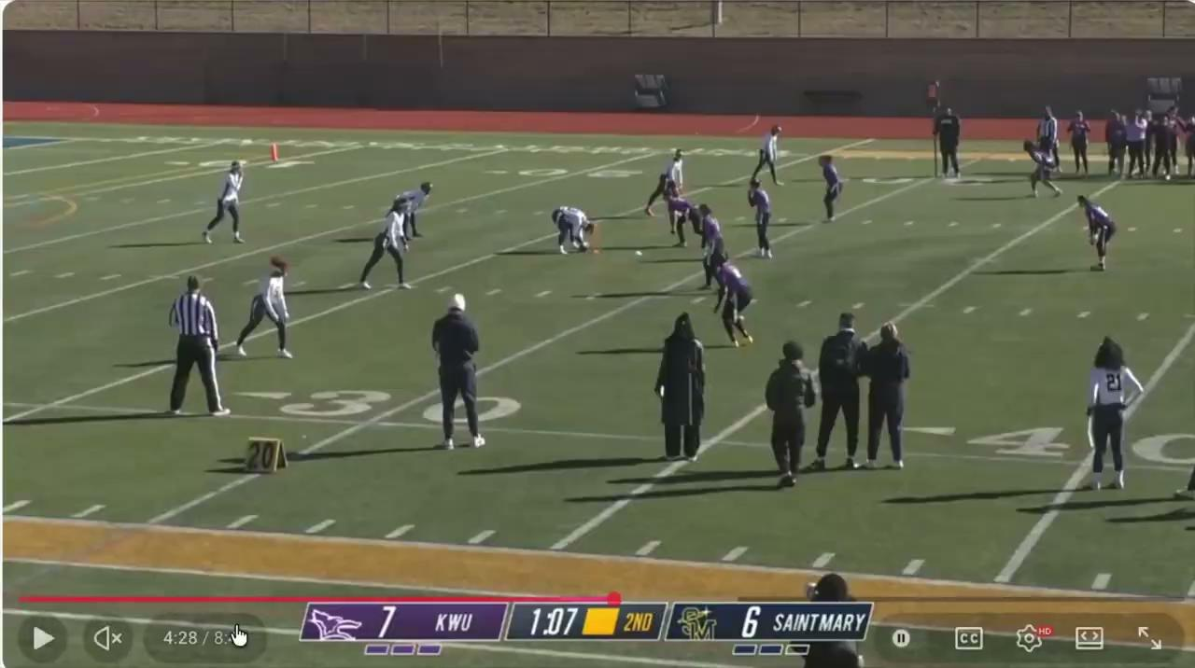

Slide 27
The Game - Kicking
Kicking
  No kickoffs – each new drives at the 14 yard line
    Exceptions: After a safety, the ball will be put in play by a scrimmage kick from the 20 yard line
  Scrimmage kicks – only punts
    K must declare punt or play on 4th down; if they delay the R will mark the ball ready for play
    Timeout required to change declaration
    If punt is declared all players must be stationary until the ball is kicked
    If punt is declared, R will hold the snap while defense subs (up to 20s on play clock)
  R can catch or recover a kick and advance
  If R muffs or fumbles the kick and it hits the ground the ball is dead
  If R muffs the kick and K recovers the ball while it is still in the air, the ball is dead and it is K’s ball
  Touchbacks – once the kick breaks the plane of the goal line, the ball is dead and it is a touchback
  Kick Catching interference – same as in tackle

Slide 28
The Game - Scoring
Scoring
  TD
    6 pt
  Try
    1 pt from the 3 yard line
    2 pt from the 10 yard line
    Drive following a try starts on the 14 yard line
  Safety
    2 pts
    Drive following a safety starts with a scrimmage kick from the 20 yd line
Starting LOS
LOS after safety
2 pt try
1 pt try

Slide 29
Common Offensive Fouls
False Start
Illegal Shift / Motion
Sideline interference
Helping the runner
Flag Guarding
Charging
Illegal Blocking / Illegal Personal Contact
Pass Interference
Intentional Grounding (loss of down)
Illegal forward pass – watch for the double pass (loss of down)

Slide 30
Common Defensive Fouls
Encroachment
Pass Interference
Holding
Charging into the player (automatic first down)
Roughing the Passer (automatic first down)
Hurdling (automatic first down)
Tripping (automatic first down)
Illegal personal contact (automatic first down)
Unsportsmanlike conduct (automatic first down)
Sideline interference 3+ (automatic first down)

